Slide 1

Inner Speech Recognition
Md. Alamgir Hossain (1806186)

Slide 2
What is Speech?
Speech is the fundamental form of human communication.
Transmits thoughts, emotions, and ideas.
Conveys responses and commands effectively
Defines individuals and enables social integration.

Slide 3
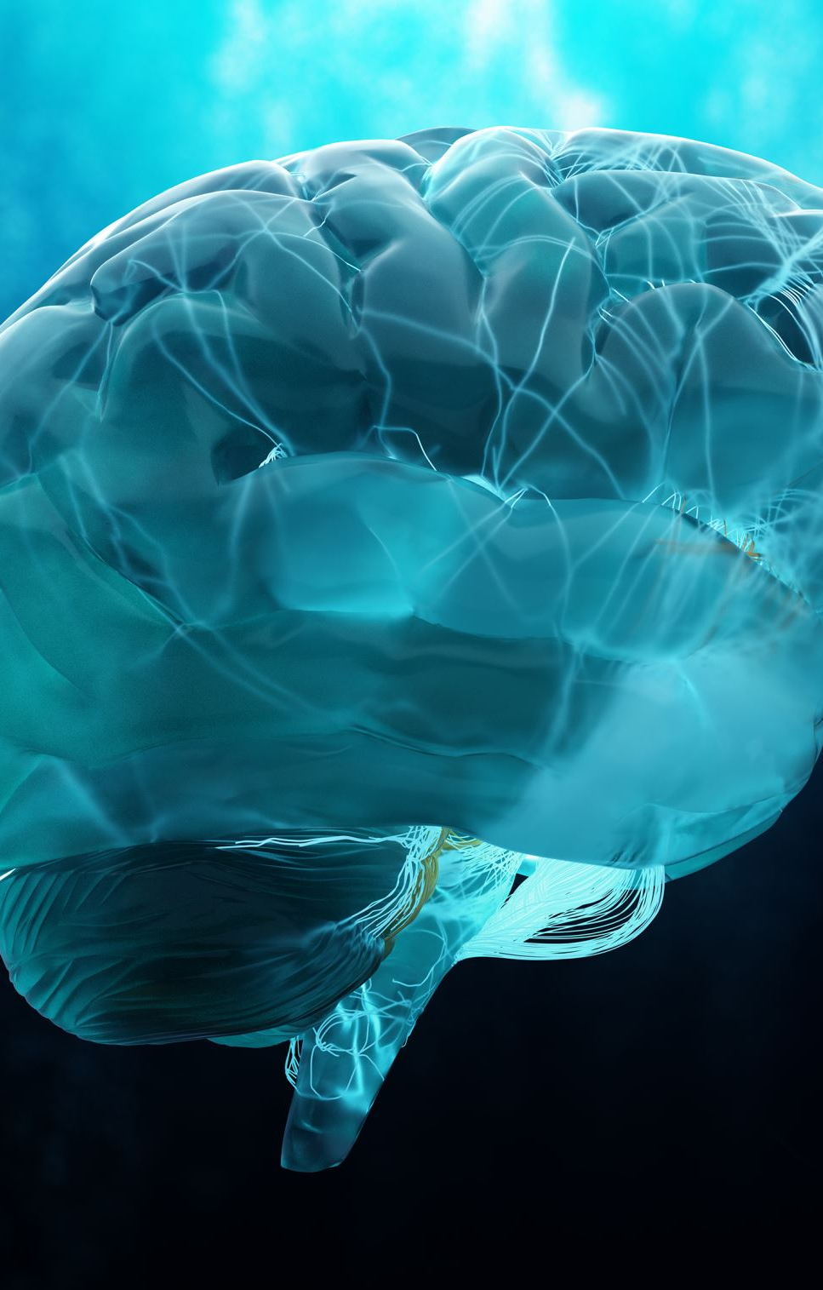
Loosing Speech Generation Power
Neurological Impact: Neurodegenerative diseases or motor disorders hinder brain-to-organ signal transmission.
Organ Dysfunction: Failure of laryngeal, respiratory, or articulatory organs can disrupt speech generation.
Disease Examples: Conditions like cerebral palsy, strokes, and ALS interrupt speech communication.
Trauma Effects: Spinal injuries and strokes can lead to speech loss.
Interdisciplinary Solutions: Rehabilitation involving medical and therapeutic approaches is necessary for speech restoration.

Slide 4
What is Inner Speech?
Inner speech refers to the silent, self-directed conversation individuals have within their minds.
Crucial for problem-solving, decision-making, and planning.
Allows for structuring and organizing thoughts before external expression.
Helps manage feelings and self-awareness through self-talk.
Supports memory consolidation and comprehension of information.

Slide 5
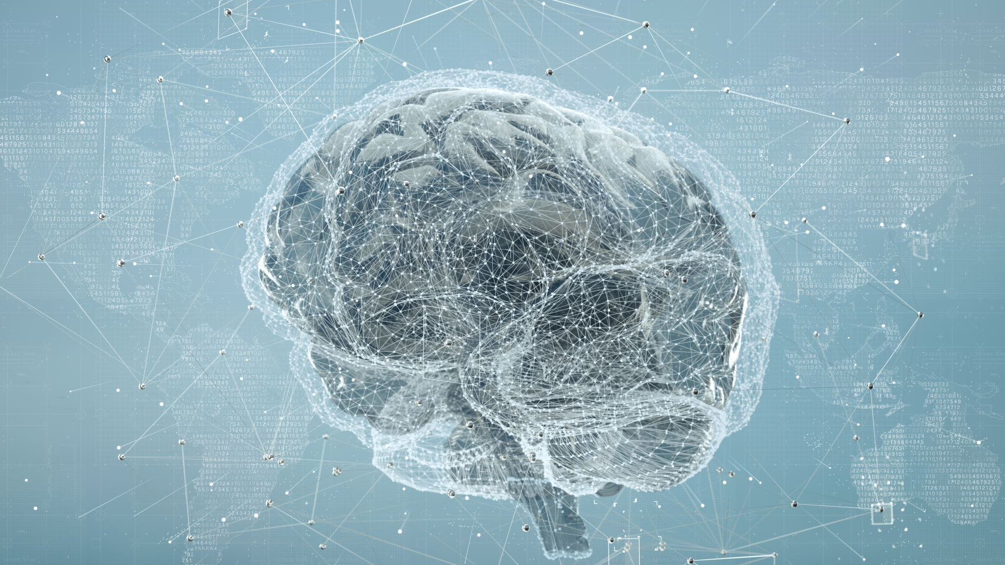
Importance of BCIs in Inner Speech
BCIs enable communication via brain signals, aiding those with speech impairments.
Users can communicate and interact using brain's natural output.
Empowers disabled individuals to engage with their environment.
BCIs extend beyond speech, offering device control and more.
Continuous research refines accuracy and personalization.

Slide 6
Background
ECoG and EEG are central methods, with ECoG offering high spatial resolution.
ECoG is chosen for spatial accuracy, though its complexity limits practical use.
EEG has lower spatial resolution but is more adaptable for real-world scenarios.
Research targets phonemes, simple words, and imagined speech for inner speech recognition.
Recent studies delve into EEG's potential to decode imagined speech patterns.

Slide 7
Related Works
Study: Wang et al. [1] focused on recognizing imagined Chinese characters for "left" and "Right"
Experimental Setup: Eight participants mentally read the characters, distinguishing them from other states.
Signal Processing Approach: EEG feature vectors extracted using CSP technique, classified using SVM.
Accurate Classification: Achieved accuracies ranged from 73.65% to 95.76% for imagined words vs. rest state, with 82.3% mean accuracy between the two words.
[1] L. Wang, X. Zhang, X. Zhong, and Y. Zhang, “Analysis and classification of speech imagery EEG for BCI,” Biomed Signal Process Control, vol. 8, no. 6, 2013, doi: 10.1016/j.bspc.2013.07.011.

Slide 8
Related Works Contd...
High Accuracy: EEG textified signals achieved an average accuracy of 83.34% in classification.
Study: González-Castañeda et al. [2] employed sonification and textification methods to classify EEG signals as audio or text.
Participant Involvement: 27 individuals imagined five words (up, down, left, right) for analysis.
Signal Processing Techniques: EEG signals were transformed using sonification and textification.
[3] M. Salama, L. Elsherif, H. Lashin, and T. Gamal, “Recognition of Unspoken Words Using Electrode Electroencephalograhic Signals,” in COGNITIVE 2014 : The Sixth International Conference on Advanced Cognitive Technologies and Applications, 2014.

Slide 9
Related Works Contd...
Modest Accuracy: Achieved accuracy ranged between 57% and 59% for word recognition
Study: Salama et al. [3] employed SVM, discriminant analysis, self-organizing map, and feed-forward back-propagation classifiers to recognize "Yes" and "No."
Classifier Variation: Different classifiers used individually and in combination for identification.
Data Collection: Seven subjects' EEG data collected using a single electrode EEG device.
[3] E. F. González-Castañeda, A. A. Torres-García, C. A. Reyes-García, and L. Villaseñor-Pineda, “Sonification and textification: Proposing methods for classifying unspoken words from EEG signals,” Biomed Signal Process Control, vol. 37, 2017, doi: 10.1016/j.bspc.2016.10.012.

Slide 10
Related Works Contd...
Accuracy Range: Reported accuracy spanned from 60% to 92% for word differentiation.
Study: Mohanchandra et al. [4] designed a one-against-all multiclass SVM classifier for distinguishing five subvocalized words.
Word Set: Words included "water," "help," "thanks," "food," and "stop."
[4] K. Mohanchandra and S. Saha, “A Communication Paradigm Using Subvocalized Speech: Translating Brain Signals into Speech,” Augmented Human Research, vol. 1, no. 1, 2016, doi: 10.1007/s41133-016-0001-z.

Slide 11
Recent Works on the selected Dataset
Research Source: Bram van den Berg et al. [5], using the Thinking Out Loud dataset.
Methodology: Employed a 2D CNN based on the EEGNet architecture for a four-word classification task.
Study Alignment: Their approach corresponds to our study's focus on similar word classification.
Data Preparation: No Extra data preprocessing was proposed
Accuracy Outcome: Reported average accuracy in their work was 29.7%.

Slide 12

Recent Works on the selected Dataset Contd...
Recent Study: Gasparini et al. [6] employed the Thinking Out Loud dataset in their research.
Deep Learning Comparison: Compared LSTM and BiLSTM deep learning models.
Classification Focus: Attempted four-class classification using different models.
LSTM Results: Achieved 30.4% best accuracy by training LSTM with essential features.
BiLSTM Performance: Achieved 33.1% accuracy using Raw data with BiLSTM model.

Slide 13
Dataset Descriptions
The studied dataset for this work is the “Thinking Out Loud” by Nieto at al.[12].
This dataset was mainly focused on controlling BCI devices using the inner speech paradigm.
They used four Spanish words – arriba (up), abajo (down), derecha (right), izquierda (left) as their inner speech.
According to Nieto at al. ten participants, including four females, all of whom were healthy and right-handed, took part in the study.
Their average age was 34 years with a standard deviation of 10 years.
None of the participants had any hearing or speech impairments, and they had no previous exposure to brain-computer interface (BCI) technology.
The research consisted of three distinct scenarios: inner speech, pronounced speech, and visualization.

Slide 14
Data Collections
Inner Speech Scenario: Participants imagined their voice, mentally repeating a word.
Pronounced Speech Scenario: Participants verbally articulated words from visual prompts.
Visualization Scenario: Participants mentally manipulated a central circle based on visual cues.
Data Acquisition: BioSemi Active Two system used with 128+8 channels, sampled at 1024 Hz.
Trials and Subjects: Trial count varied per subject; detailed acquisition and trial information in [12]

Slide 15

Applied Algorithms

Slide 16
Applied Algorithms
2D Convolution by considering the data as image and got the accuracy of 26.3%
1D Convolution (after converting the data into 1D) on the raw dataset, got the accuracy of 25%
Applied ResNet9 architechture and got the accuracy of 26.3%

Slide 17

Applying CSP Algorithm on the RAW data

Slide 18
Applying CSP...
Achieved 81% accuracy using Logistic Regression
Achieved 80% accuracy using SVC Algorithm
Achieved 68% accuracy using Random Forrest Classifier
Achieved 74% accuracy using Gradient Boosting Classifier

Slide 19
References
[12] N. Nieto, V. Peterson, H. L. Rufiner, J. E. Kamienkowski, and R. Spies, “Thinking out loud, an open-access EEG-based BCI dataset for inner speech recognition,” Sci Data, vol. 9, no. 1, 2022, doi: 10.1038/s41597-022-01147-2.
[2] J. R. Wolpaw, N. Birbaumer, D. J. McFarland, G. Pfurtscheller, and T. M. Vaughan, “Brain-computer interfaces for communication and control,” Clinical Neurophysiology, vol. 113, no. 6. 2002. doi: 10.1016/S1388-2457(02)00057-3.
[11] B. van den Berg, S. van Donkelaar, and M. Alimardani, “Inner Speech Classification using EEG Signals: A Deep Learning Approach,” in Proceedings of the 2021 IEEE International Conference on Human-Machine Systems, ICHMS 2021, 2021. doi: 10.1109/ICHMS53169.2021.9582457.

Slide 20

THANK YOU

